Slide 1

Lab 2.4 Implement SARSA
Notes:
1

Slide 2
Objectives
This example demonstrates how SARSA can be used to learn the optimal policy for a grid world environment by updating the Q-values based on observed rewards and subsequent actions taken.
Lab 2.4 Implement SARSA
2
Notes:
2

Slide 3
Lab Guide Coding
Using given code
We define a simple grid world environment using the GridWorld class, where the agent can move up, down, left, or right, with a goal state at position (3, 3).
The epsilon_greedy_policy function implements an epsilon-greedy policy for action selection.
Lab 2.4 Implement SARSA
3
Notes:
3

Slide 4
Lab Guide Coding
Using given code
The sarsa function performs the SARSA algorithm to learn the optimal policy for the given grid world.
We set hyperparameters such as the learning rate (alpha), discount factor (gamma), and exploration parameter (epsilon).
Finally, we run SARSA to learn the optimal policy and print the learned Q-value function.
Lab 2.4 Implement SARSA
4
Notes:
4

Slide 5
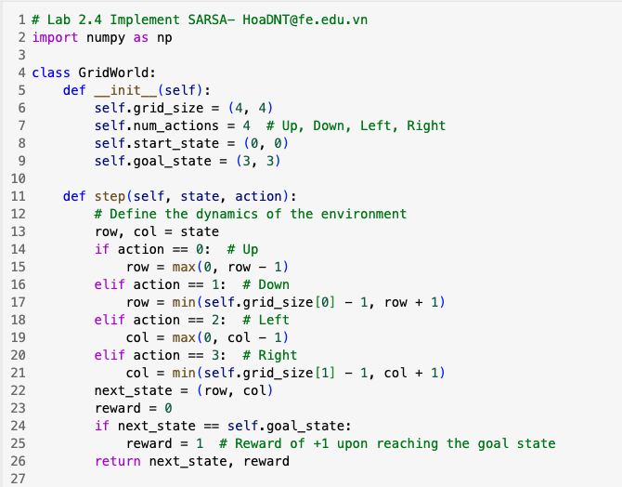
Lab Guide Coding
Lab 2.4 Implement SARSA
5
Notes:
5

Slide 6
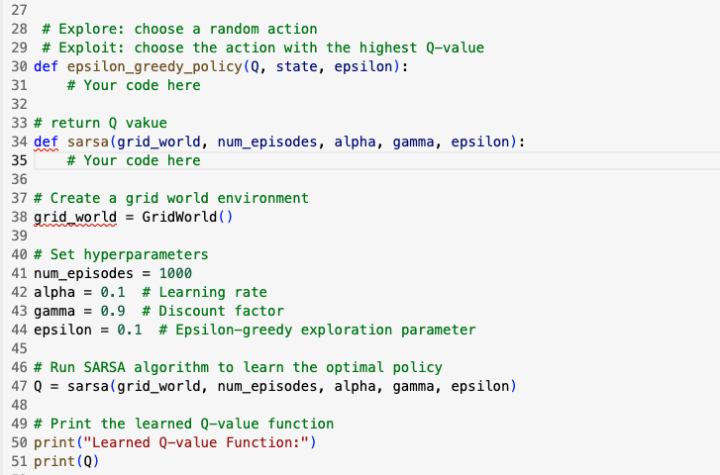
Lab Guide Coding
Lab 2.4 Implement SARSA
6
Notes:
6

Slide 7
Q & A
Lab 2.4 Implement SARSA
7

